Slide 1
Guide to Debugging
EE 16B
Spring 2018

Slide 2
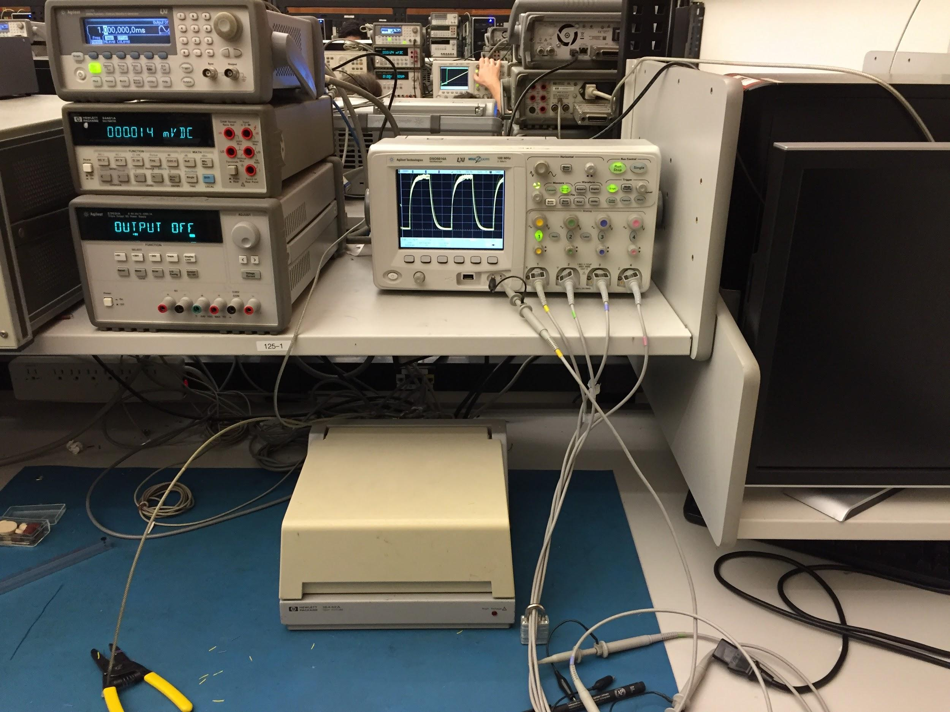
Your Lab Bench Setup
Somebody’s Hand
Oscilloscope
Function Generator
Digital Multimeter
Power Supply

Slide 3
Power Supply Checklist
Power supply is turned on
Output is on
Set your voltages appropriately
Current limit is set appropriately (0.1A)
Positive terminal connected to the appropriate breadboard power rails
Negative terminal connected to all breadboard ground rails
Video: Power Supply Video

Slide 4
Digital Multimeter (DMM) Checklist
DMM is set to measure correct unit (i.e. V, A, R, etc.)
Probes are connected to the correct plugs
Probes placed in parallel to measure voltage, series to measure current
Video: DMM Video

Slide 5
Function Generator Checklist
Turned on
Positive terminal connected to designated input
Negative terminal connected to all breadboard ground rails
Port impedance is set to High-Z
Output is on
Output waveform is as expected
Video: Function Generator Video

Slide 6
Oscilloscope Checklist
Probe ground clips are connected to a breadboard ground rail
Voltage and time scales are appropriate and reasonable
The green “Run” button is lit up
Trigger level is appropriately set
Guide:
Oscilloscope Cheatsheet
Oscilloscope Video

Slide 7
Becoming Better Friends With Your Scope

Slide 8
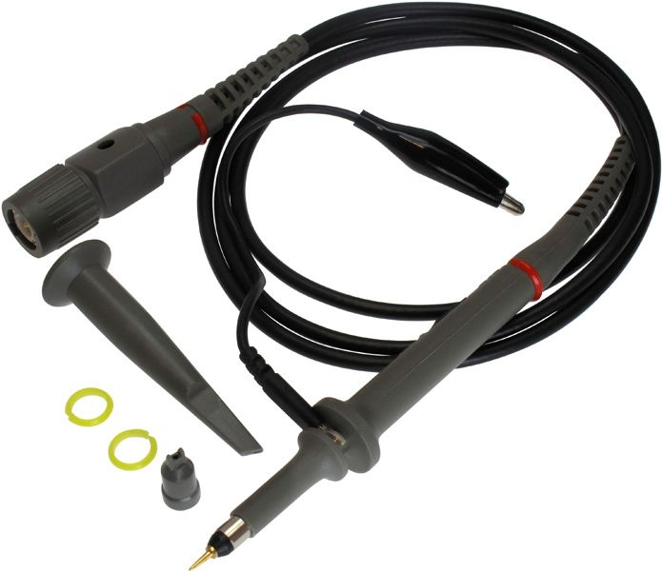
Oscilloscope
Knowing how to use your scope will help you track down clues.
Collecting clues only matters if you know what you are looking at
Goes to ground. No excuses.
Hook-shaped tip detachable. Connect this to a wire instead of probing breadboard directly.

Slide 9
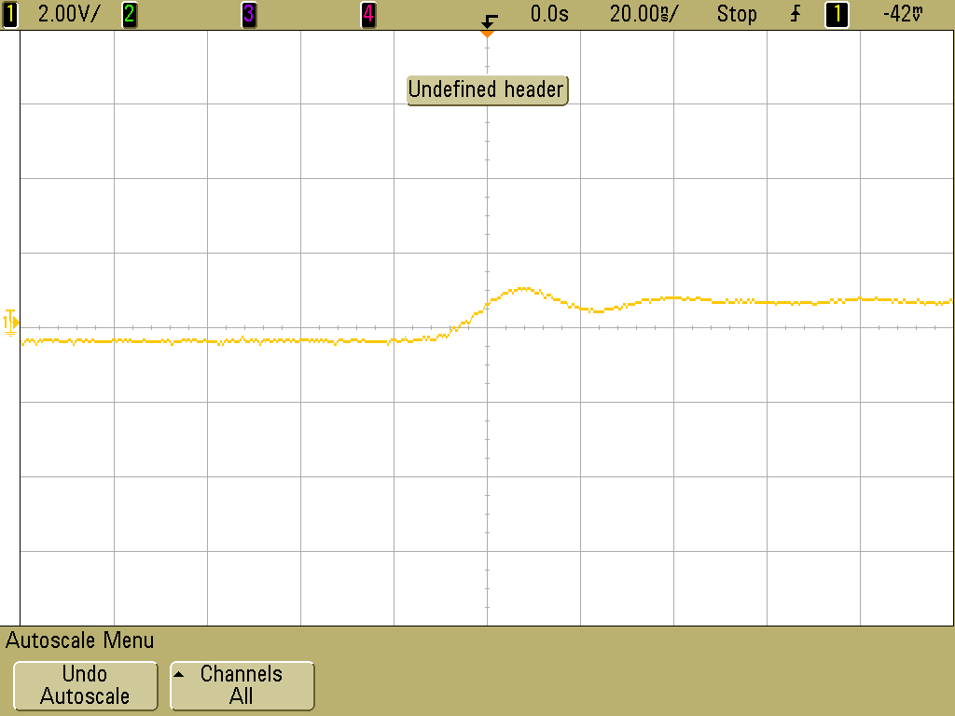
Auto Scale can be Dumb
Notes:
AG: what does this mean?

Slide 10
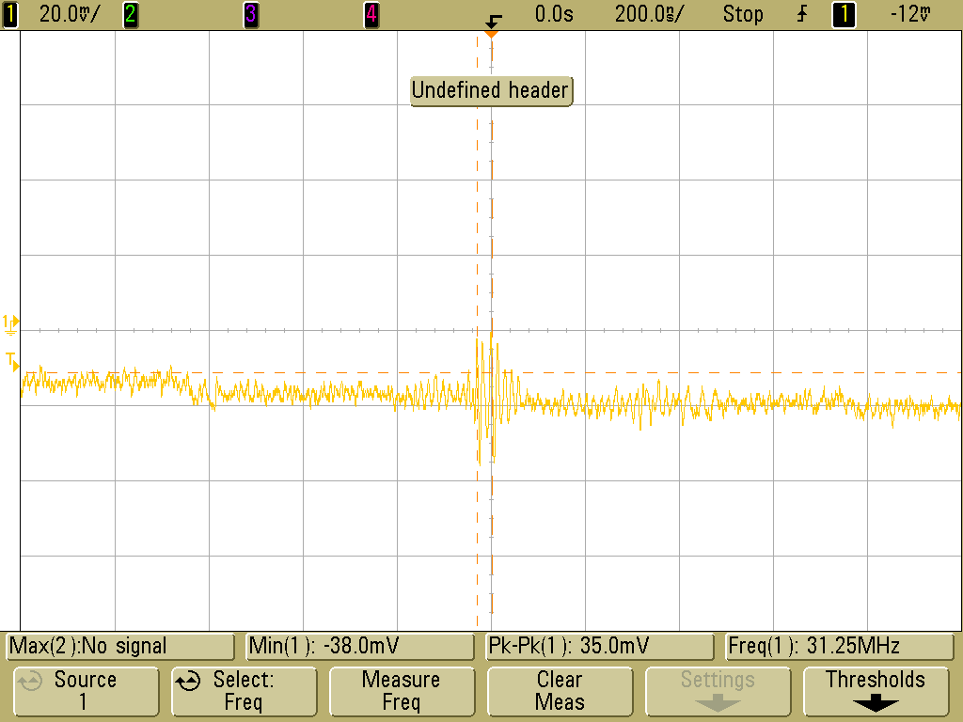
Note the Division Scale
Time and Voltage are too small
Notes:
What’s going on here?

Slide 11
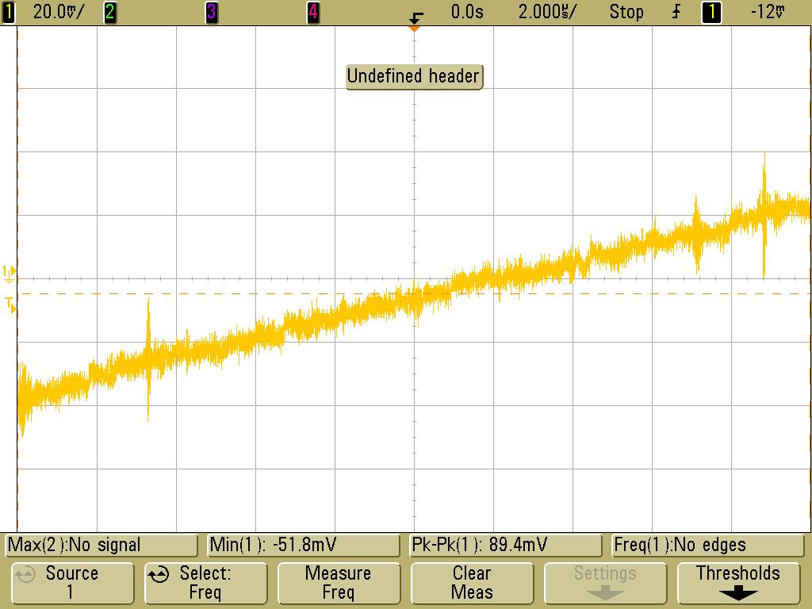
Zoom Out

Slide 12
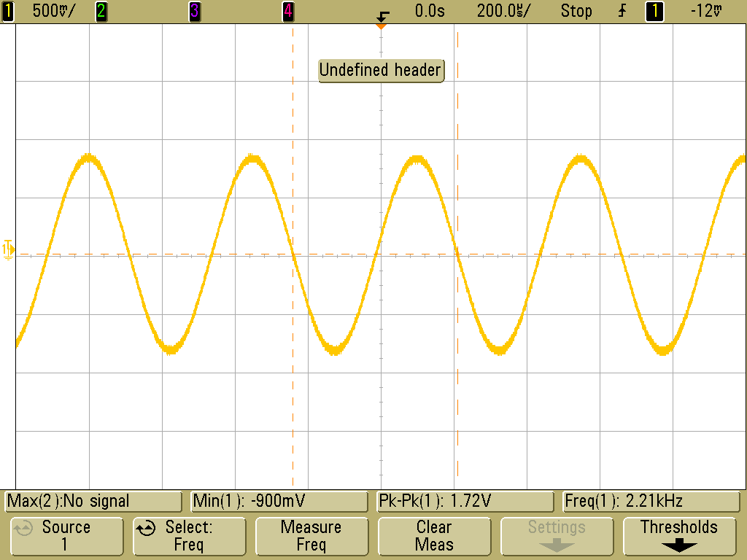
Zoom Out More

Slide 13
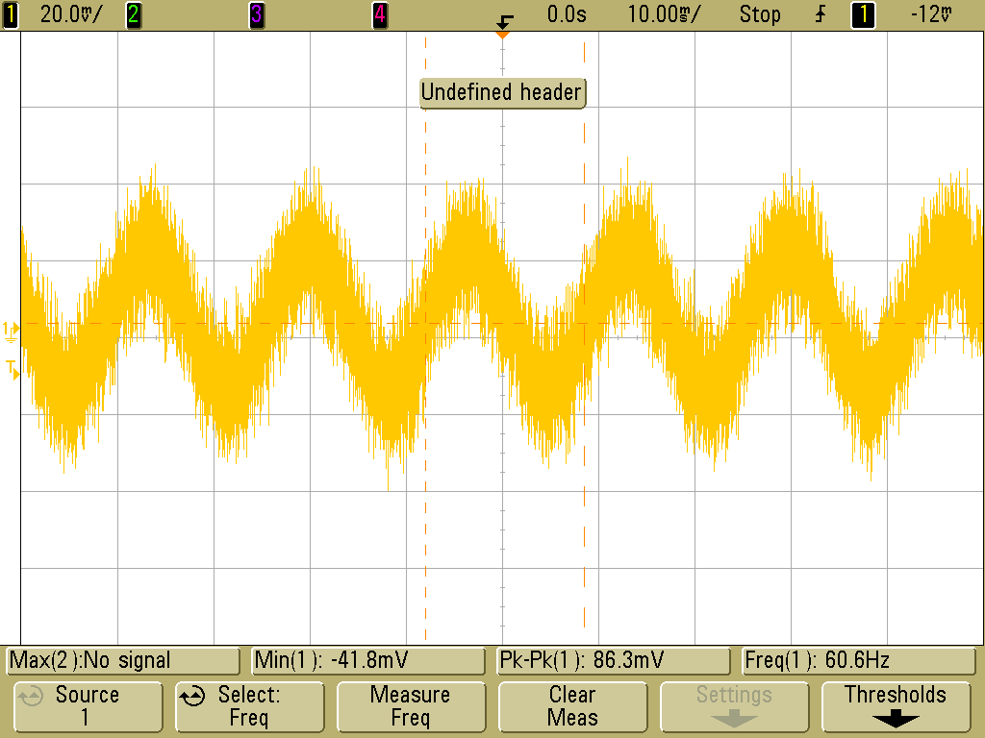
60 Hz Noise from building power
If you see this, something is not grounded and is picking up noise.

Slide 14
Most Important
Stupid Happens. But, it happens less with two brains.
Let your partner rebuild the circuit. Step back and check each other’s thinking. Don’t get stuck in a rut.
Don’t give up!
Engineering requires Truck Loads of Stubborn and The Belief That it Will Work Eventually. Because it will work. You just have to keep looking for clues until you get there.

Slide 15
Breadboard Layout

Slide 16
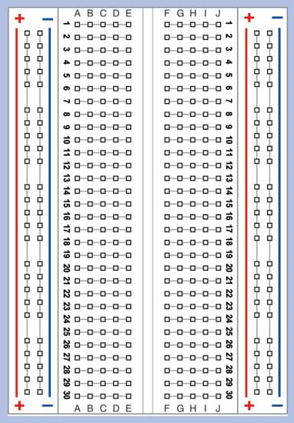
Breadboards
Terminal Strips
Terminal strips (rows) are connected in groups of 5
Rails (side columns) are for power/ground
Use red wire for power
Use black wire for ground. All grounds should be connected together
Chips should straddle the notch
Connected
Connected
Notch
Rails

Slide 17
Breadboard Layout Guidelines
Plan ahead
Shorten leads
Color code your wires
Reduce length and number of wires
If you wish to receive help, you must first check that your breadboard follows these guidelines. Otherwise, you will not receive help debugging.

Slide 18
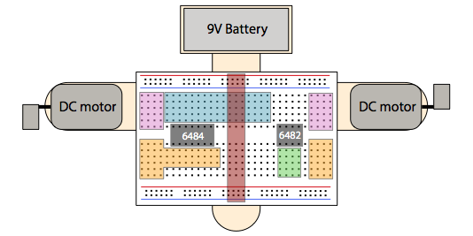
Plan Ahead
Before you begin, take a few minutes to get a good idea of how to fit your project onto the breadboard. This will avoid space management problems in the future.

Slide 19
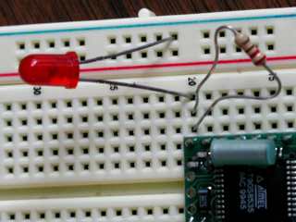
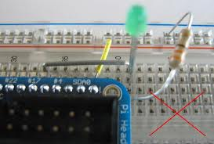
Shorten uninsulated leads
Long uninsulated leads can easily contact each other. This causes undesired short circuits and may even burn out your components.

Slide 20
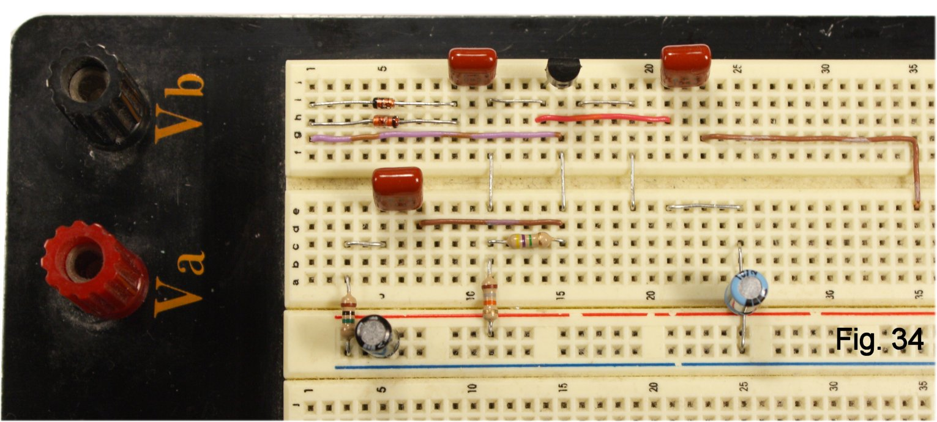
Shorten uninsulated leads
Cut leads and wires to be only as long as necessary.
(Planning ahead is important before you cut the wires)

Slide 21
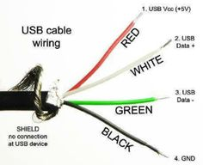
Color code your wires
Mandatory color convention
Red = power
Black = ground
If you don’t follow this convention, we will not help you debug
Other colors used for all other connections, but should organized, clear, and methodical

Slide 22
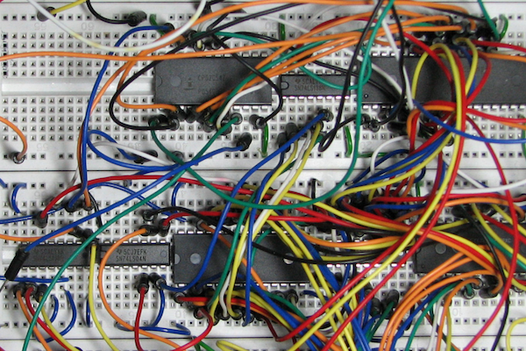
Reduce length/number of wires
Nobody can figure out what’s going on here. A messy breadboard will give you a headache.

Slide 23
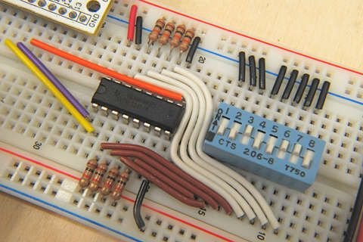
Reduce length/number of wires
You should use as few wires as possible and make them as short as possible

Slide 24
Debugging Circuits

Slide 25
Debugging is Detective Work
How do we track down mistakes?
You can’t debug what you don’t understand
Always know what you expect to happen

Slide 26

First Step: Build the Circuit
Circuits are building blocks
Start with the smallest part of the circuit (e.g., connect power rails)
Build up once the first blocks work
Take your time, check your work over and over as you go
It might seem slow, but you save time later

Slide 27
The Inevitable Bug
You were careful building your circuit, but your scope isn't showing the right output. What now?
The wrong answer is not necessarily useless.
Think about what in your circuit might cause the output you are getting.
Collect clues!

Slide 28
Flow Chart!
Is the output what you expect?
Is the next step back what you expect?
No
Yes
Y
No
Fix it
DONE!

Slide 29
Back it Up
The scope is your best friend!
Power
Check that each chip is actually getting power
Check that your source is not current limited
Previous signals
If an earlier signal is what you expect, then something after that point in your circuit is the problem

Slide 30
Back Back it Up
Are the wires in the right row?
Check that each wire is actually connected
Are your wire connections in securely?
Press and wiggle wires
Check connectivity using DMM
Worst case: use the multimeter or replace the wires

Slide 31
Back Back Back it Up
Back all the way up to the function generator
Use the scope to make sure the input signal is correct.
Are the wires really REALLY correct?
Try tearing up a messy circuit and just trying again.
Back all the way up to your schematic
Check the datasheet
Is your wiring diagram correct?

Slide 32
Last Resort
Is the hardware broken?
Change components
Change wires
Change pins on launchpad
Check probe is not broken by connecting to the test signal on the scope
Rebuild the circuit
Tear everything up and retry. There is a very good chance that this will fix everything.

Slide 33
Quiz
Take the lab quiz linked in IPython notebook
You must get 100% to be checked off!

